Slide 1
Introduction to Distributed Systems
PROF ASHOK PATADE

Slide 2
Introduction to Distributed Systems
1.1 Characterization of Distributed Systems: Issues, Goals, and Types of distributed systems, Distributed System Models, Hardware concepts, Software Concept.
1.2 Middleware: Services offered by middleware, Client Server model.

Slide 3
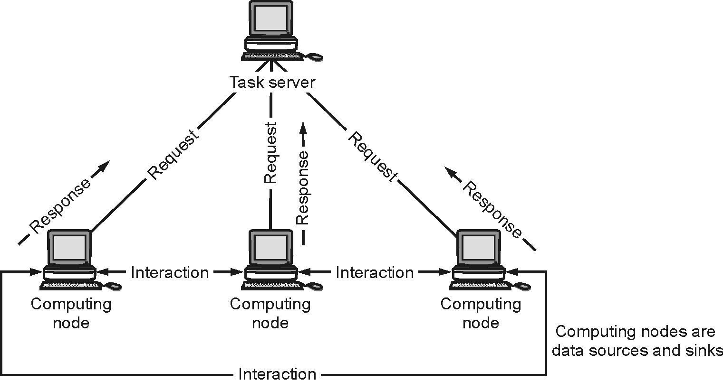
Introduction to Distributed Systems
Fig 1.1.1 : Architecture of Distributed Systems

Slide 4
Characteristics of Distributed System
Distributed systems have the following characteristics :
(1) No standard physical clock.
(2) It has improved reliability.
(3) Improvement in the performance/cost ratio.
(4) Access to distant information and resources.
(5) Distributed systems are scalable.

Slide 5
Advantages of Distributed System

Slide 6
Disadvantages of Distributed System

Slide 7
Applications Area of Distributed System

Slide 8
Issues in Distributed System
(1) Heterogeneity
(2) Openness
(3) Scalability
(4) Security
(5) Failure handling
(6) Concurrency
(7) Transparency

Slide 9
Types of Transparencies
(1) Access Transparency
(2) Location Transparency
(3) Concurrency Transparency
(4) Replication Transparency
(5) Failure Transparency
(6) Migration Transparency
(7) Performance Transparency
(8) Scaling Transparency

Slide 10
Goals of Distributed Systems
(1) Bringing Users and Resources Together
(2) Transparency
(3) Openness
(4) Scalability
(5) Reliability
(6) Performance

Slide 11
Types of Distributed System
Distributed Computing Systems
(A) Cluster Computing
(B) Grid Computing
Distributed Information Systems
Transaction Processing Systems
Enterprise Application Integration
Distributed Pervasive Systems

Slide 12
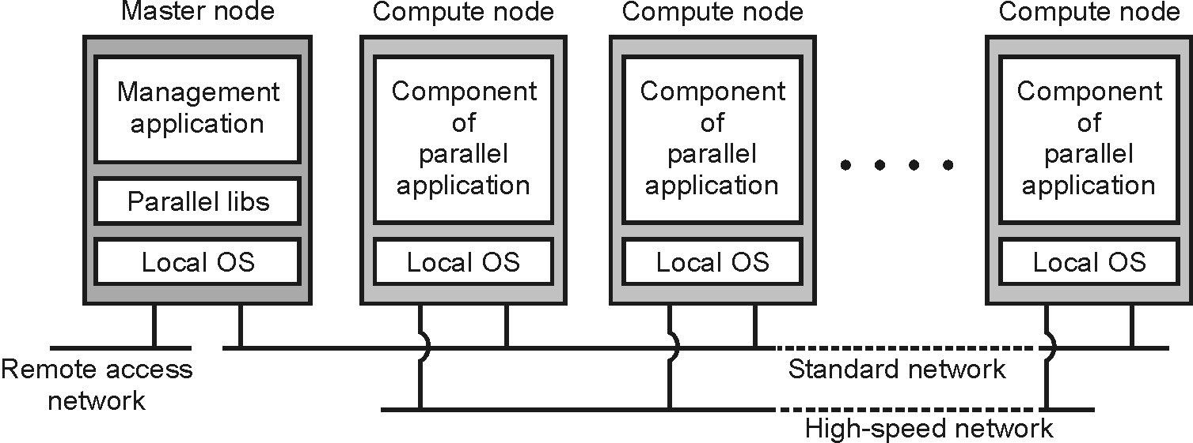
Cluster Computing
Fig. 1.4.1 : Cluster Computing System

Slide 13
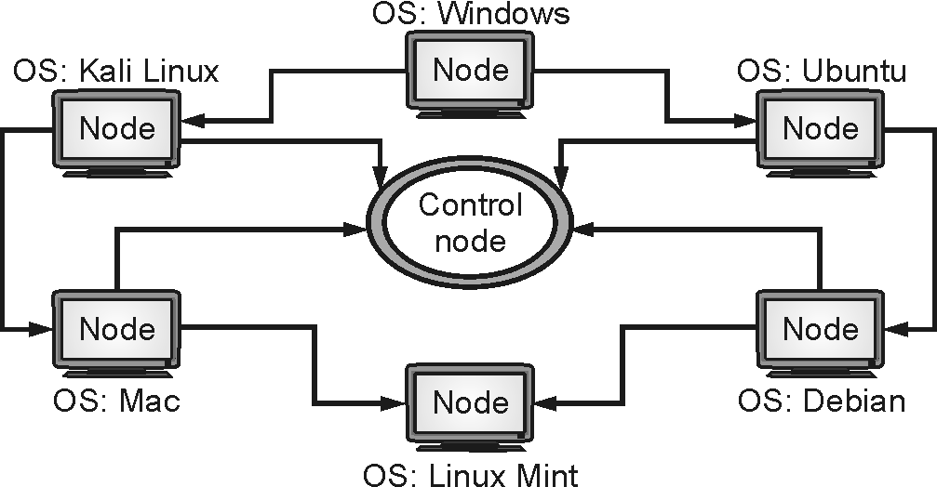
Grid Computing
Fig. 1.4.2 : Grid Computing System

Slide 14
Distributed System Models
Physical Model
(A) Early distributed systems
(B) Internet-scale distributed systems
(C) Contemporary distributed systems
(D) Types of Physical Models Based on Hardware and Computation
(1) Minicomputer Model
(2) Workstation Model
(3) Workstation-Server Model
(4) Processor-Pool Model
(5) Hybrid Model

Slide 15
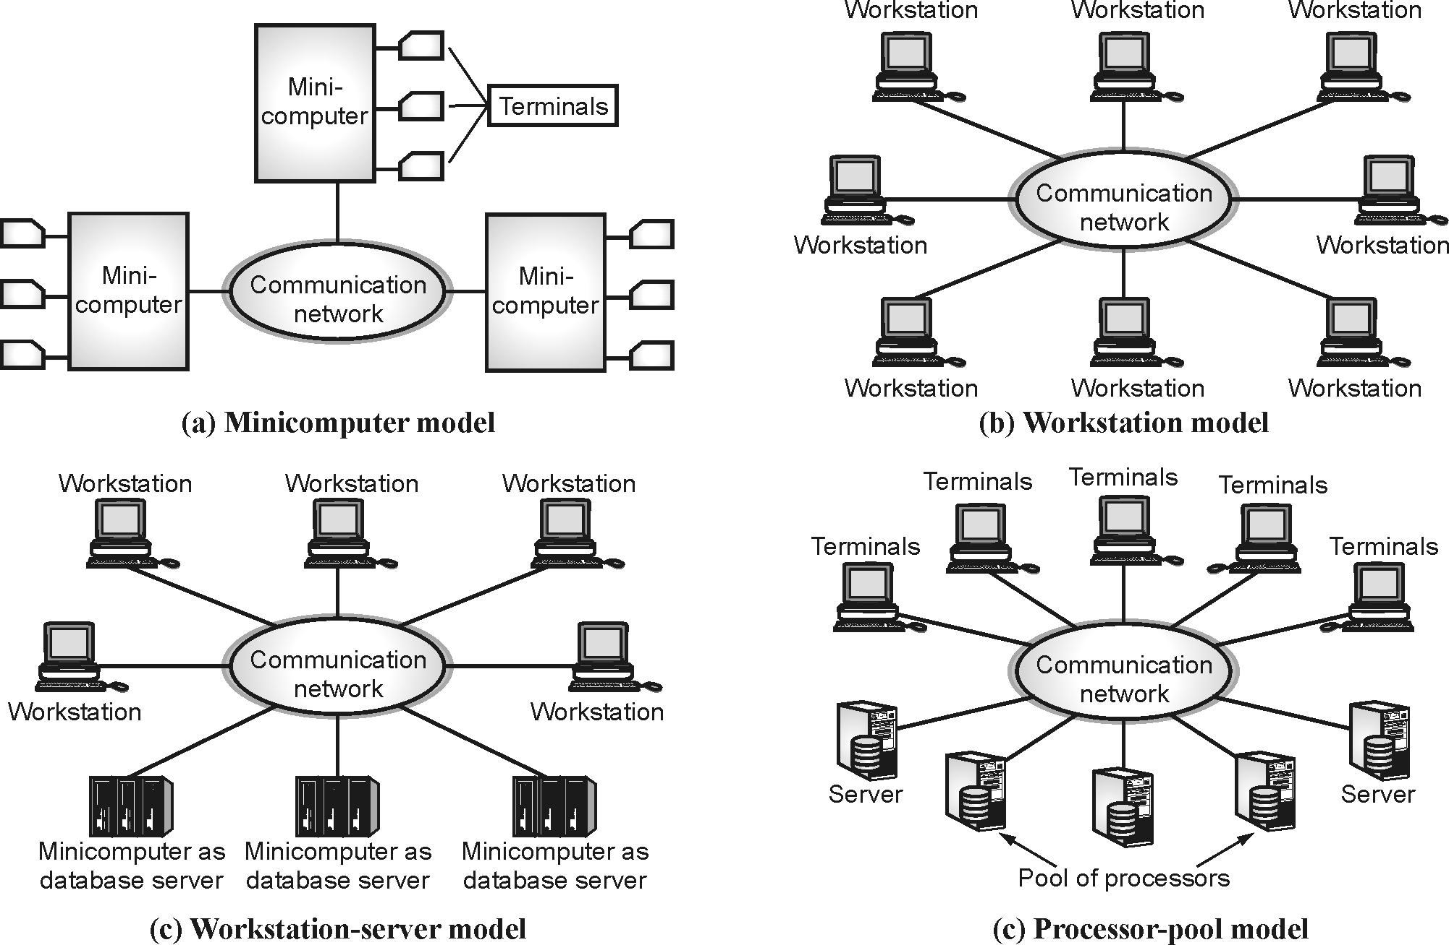
Types of Physical Models Based on Hardware and Computation
Fig. 1.5.1 : Distributed System Physical Models

Slide 16
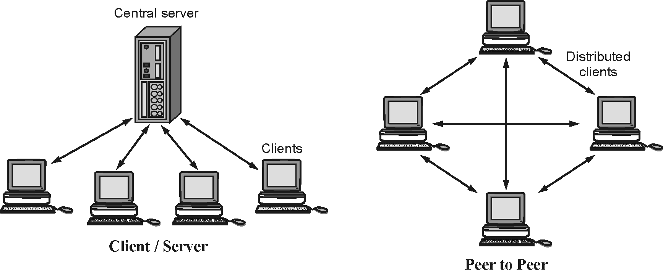
Distributed System Models
Architectural Model
(A) Client-Server Model
(B) Peer-to-Peer Model
Fig. 1.5.2 : Distributed Architectural Model

Slide 17
Comparison between Client-server and Peer-to-Peer Model
Basis of Comparison | Client-Server Model | Peer-to-Peer Model
Basic | In a client-server network, we have a specific server and specific clients connected to the server. | In a peer-to-peer network, clients are not distinguished; every node act as a client and server.
Expense | A Client-Server network is more expensive to implement. | A Peer-to-Peer is less expensive to implement.
Stability | It is more stable and scalable than a peer-to-peer network. | It is less stable and scalable, if the number of peers increases in the system.
Data | In a client-server network, the data is stored in a centralized server. | In a peer-to-peer network, each peer has its own data.
Server | A server may get overloaded when many customers make simultaneous service requests. | A server is not bottlenecked since the services are dispersed among numerous servers using a peer-to-peer network.
Focus | Sharing the information. | Connectivity.
Service | The server provides the requested service in response to the client's request. | Each node has the ability to both request and delivers services.
Performance | Because the server does the bulk of the work, performance is unaffected by the growth of clients. | Because resources are shared in a big peer-to-peer network, performance will likely to suffer.
Security | A Client-Server network is a secured network because the server can verify a client's access to any area of the network, making it secure. | The network's security deteriorates, and its susceptibility grows as the number of peers rises.

Slide 18
Distributed System Models
Fundamental Model
(A) Interaction Model
(B) Fault Model
(C) Security Model

Slide 19
Hardware Concepts
Hardware in distributed systems can be organized in several different ways
(1) Multiprocessor System
(2) Multicomputer Systems

Slide 20
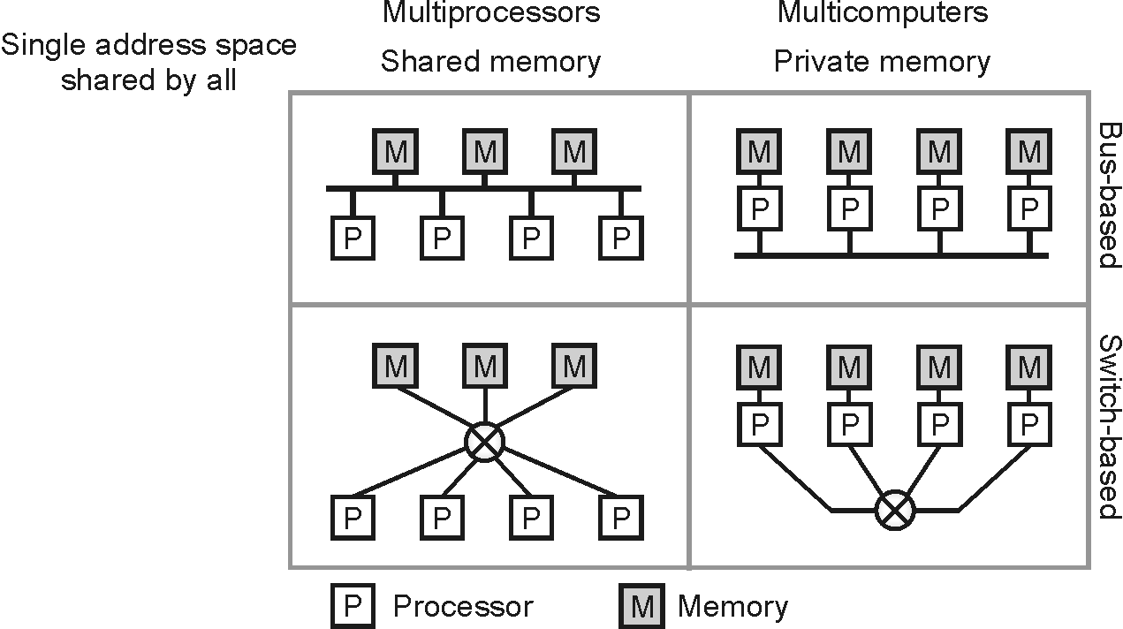
Multiprocessor System

Slide 21
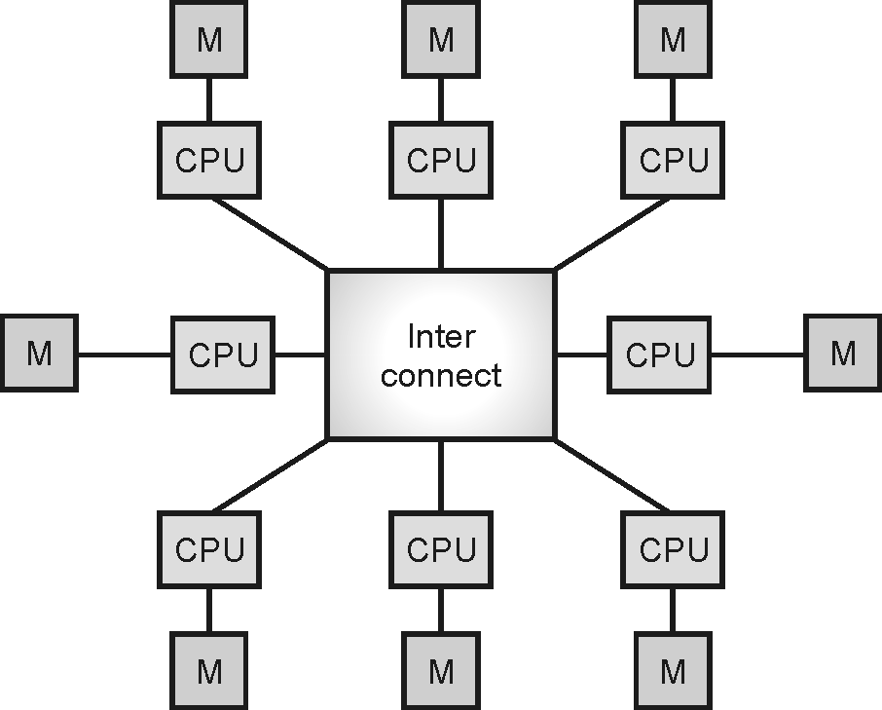
Multicomputer Systems
Fig. 1.6.2 : Multicomputer System

Slide 22
Difference Between Multiprocessor and Multicomputer Systems
Sr. No. | Multiprocessor System | Multicomputer System
(1) | A multiprocessor is a system with two or more central processing units (CPUs) that can perform multiple tasks. | A multicomputer is a system with multiple processors that are attached via an interconnection network to perform a computation task.
(2) | A multiprocessor system is a single computer that operates with multiple CPUs. | A multicomputer system is a cluster of computers that operate as a singular computer.
(3) | Construction of multiprocessor is difficult and cost ineffective than a multicomputer. | Construction of multicomputer is easier and cost effective than a multiprocessor.
(4) | In multiprocessor system, program tends to be easier. | In multicomputer system, program tends to be more difficult.
(5) | Multiprocessor supports parallel computing. | Multicomputer supports distributed computing.

Slide 23
Software Concepts
Distributed Operating Systems
Network Operating System
Middleware

Slide 24
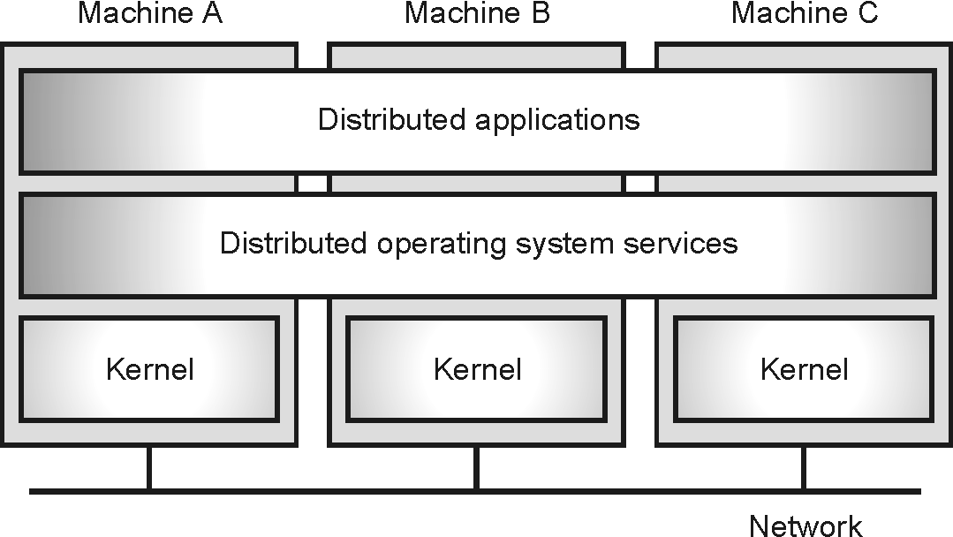
Distributed Operating Systems

Slide 25
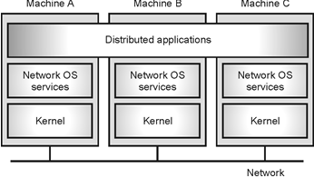
Network Operating System

Slide 26
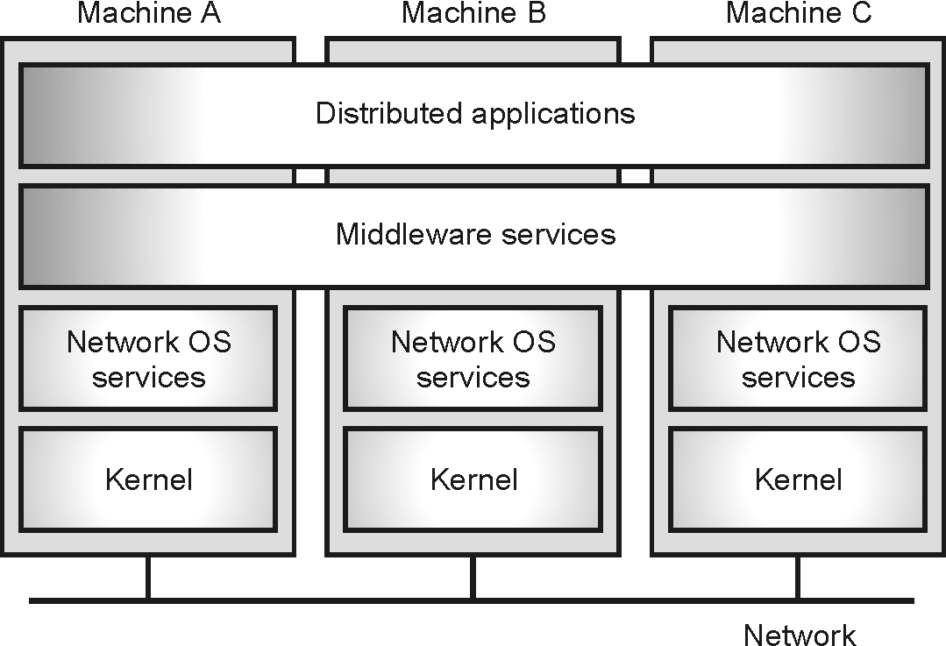
Middleware

Slide 27
Comparison between the DOS, NOS, and Middleware
Sr. No. | Features | Distributed Operating System |  | Network Operating System | Middleware
 |  | Multiprocessor | Multicomputer
(1) | Degree of Transparency | Very High | High | Low | High
(2) | Same OS on all nodes | Yes | Yes | No | No
(3) | Number of copies of OS | 1 | N | N | N
(4) | Basis for Communication | Shared Memory | Messages | Files | Model Specific
(5) | Resource Management | Global, central | Global, distributed | Per node | Per node
(6) | Scalability | No | Moderately | Yes | Varies
(7) | Openness | Closed | Closed | Open | Open

Slide 28
Services offered by Middleware
(1) Communication services
(2) Information services
(3) Control Services
(4) Security Services
(5) Persistence
(6) Messaging
(7) Querying
(8) Concurrency

Slide 29
Types of Middleware
(1) Message Oriented Middleware (MOM)
(2) Object Middleware
(3) RPC Middleware
(4) Database Middleware
(5) Transaction Middleware
(6) Portal Middleware
(7) Content-centric Middleware
(8) Embedded Middleware

Slide 30
Models of Middleware
(1) Client-server model
(2) Vertical distribution model
(3) Horizontal distribution model
(4) Peer-to-Peer Model
(5) Hybrid Model

Slide 31
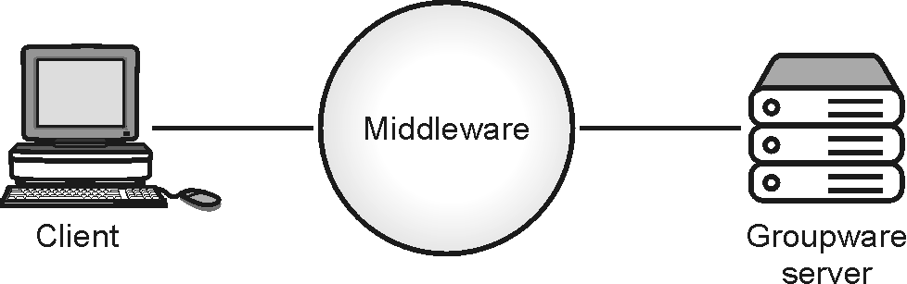
Client-server model

Slide 32
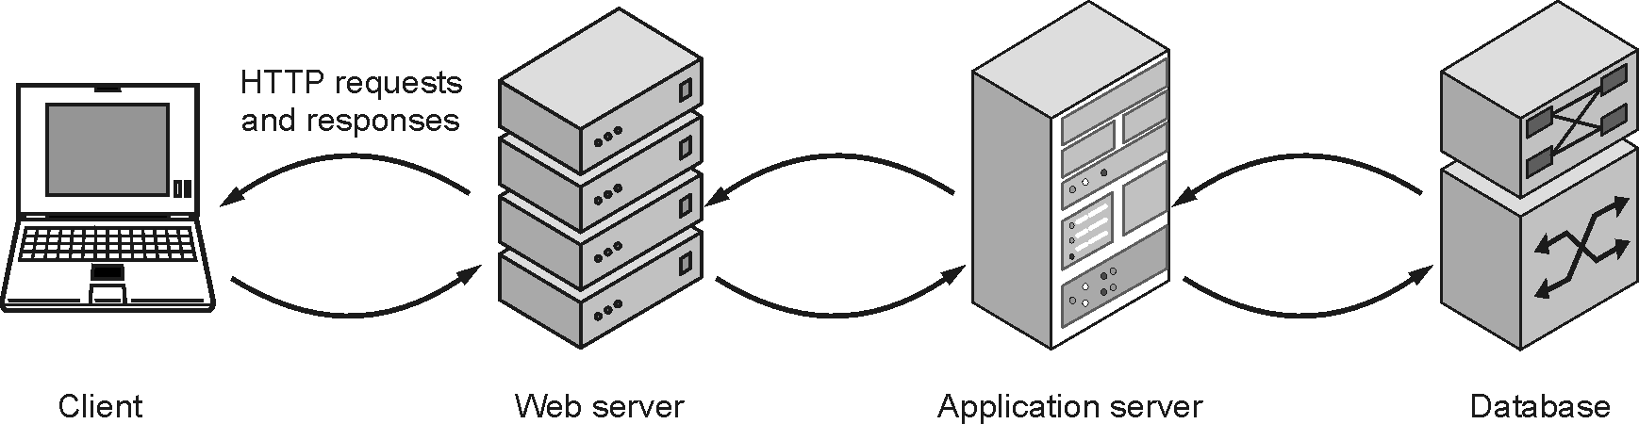
Vertical distribution model

Slide 33
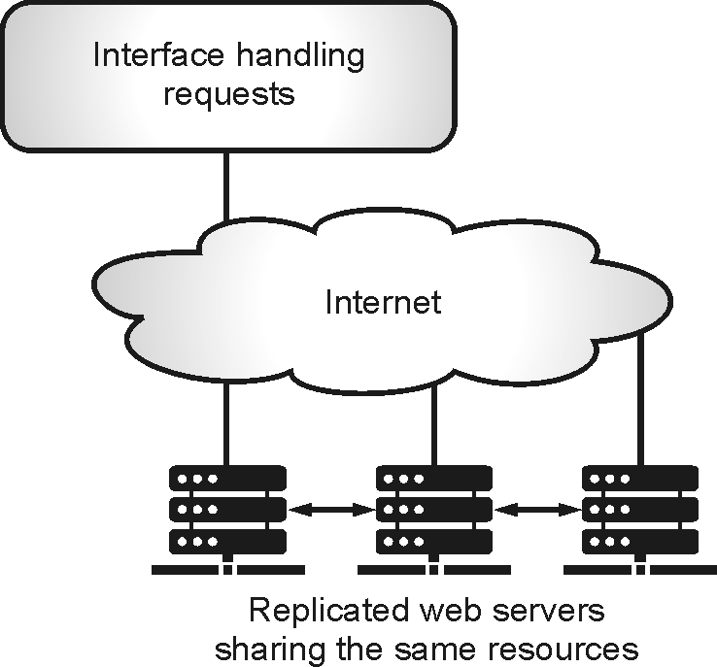
Horizontal distribution model

Slide 34
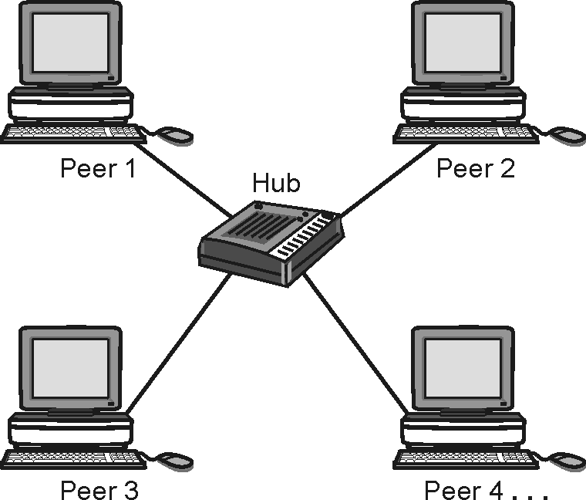
Peer-to-Peer Model

Slide 35
Client-Server Architectural Model
(1) 1-Tier Architecture
(2) 2-Tier Architecture
(3) 3-Tier Architecture
(4) n-Tier Architecture

Slide 36
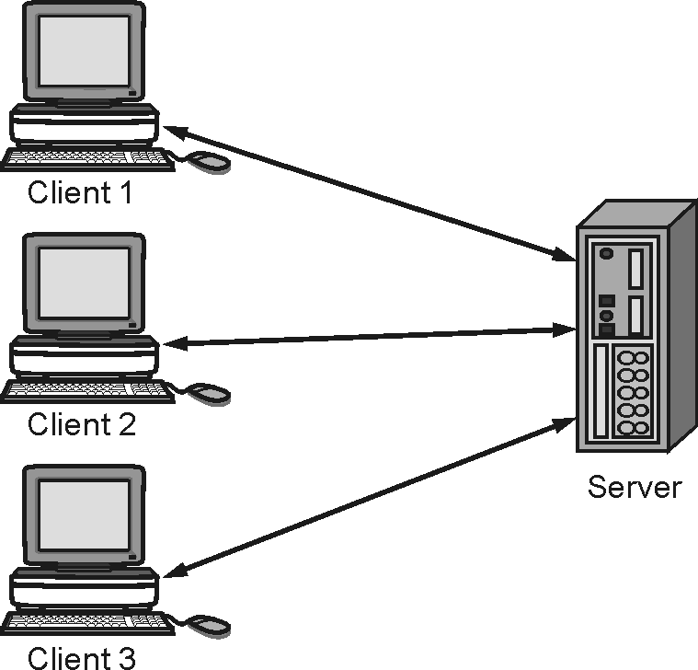
2-Tier Architecture
Fig. 1.11.2 : 2-Tier Client-Server Architecture

Slide 37
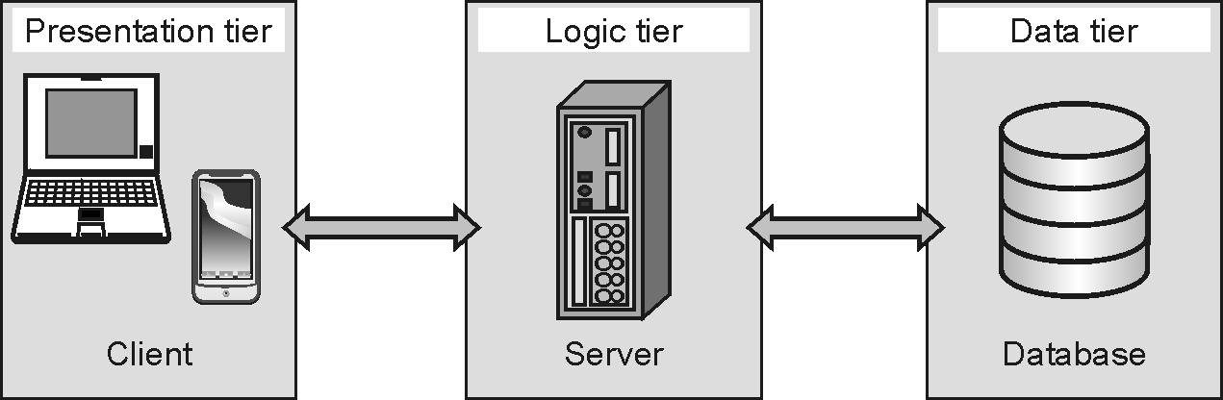
3-Tier Architecture :

Slide 38
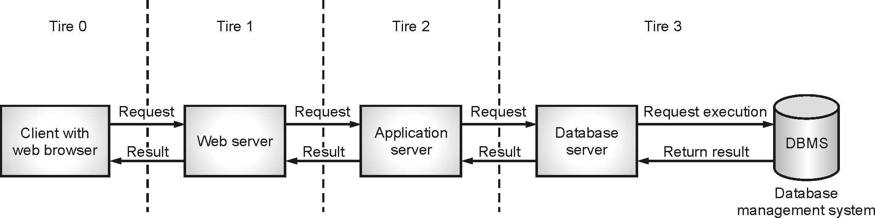
n-Tier Architecture

Slide 39
Thank you!!!
ashok.patade@djsce.ac.in

